Slide 1
Theory of equations
Chapter 2

Slide 2
Factor theorem
Factor theorem is a special kind of the polynomial remainder theorem that links the factors of a polynomial and its zeros. The factor theorem removes all the known zeros from a given polynomial equation and leaves all the unknown zeros. The resultant polynomial has a lower degree in which the zeros can be easily found.

Slide 3
Factor Theorem Statement
The factor theorem states that if f(x) is a polynomial of degree n greater than or equal to 1, and 'a' is any real number, then (x - a) is a factor of f(x) if f(a) = 0. In other words, we can say that (x - a) is a factor of f(x) if f(a) = 0. Let us now understand the meaning of some concepts related to the factor theorem.
Zero of a Polynomial
Before learning about the factor theorem, it is essential for us to know about the zero or a root of the polynomial. We say that y = a is a root or zero of a polynomial g(y) only if g(a) = 0. We can also say that y = a is a root or zero of a polynomial only if it is a solution to the equation g(y) = 0. Let's consider an example to find the zeros of the second-degree polynomial g(y) = y² + 2y − 15. To do this we simply solve the equation by using the factorization of quadratic equation method as:

Slide 4
y² + 2y − 15
= (y+5)(y−3)
= 0
⇒ y =−5 and y = 3
Thus, this second-degree polynomial y² + 2y − 15 has two zeros or roots which are - 5 and 3.
Factor Theorem Formula
As per the factor theorem, (y – a) can be considered as a factor of the polynomial g(y) of degree n ≥ 1, if and only if g(a) = 0. Here, a is any real number. The formula of the factor theorem is g(y) = (y – a) q(y). It is important to note that all the following statements apply for any polynomial g(y):
(y – a) is a factor of g(y).
g(a) = 0.
The remainder becomes zero when g(y) is divided by (y – a).
The solution to g(y) = 0 is a and the zero of the function g(y) is a.

Slide 5
MULTIPLICITY OF A ROOT
Polynomial division
Here is an algorithm that determines the multiplicity of a root using polynomial division:
Count the number of times that you can repeatedly divide p(x)p(x) by x−x0x−x0 and still get a remainder of zero.
If after the first division, the remainder is not zero, then x0x0 is not a root and we could say that the multiplicity is zero.
Otherwise, if we were able to divide out x−x0x−x0 a total of kk times, and each of the kk times the remainder was zero, but with the (k+1)(k+1)^{th} polynomial division, the remainder was non-zero, then the multiplicity of the root x0x0 is kk.

Slide 6
The Fundamental Theorem of Algebra
If p(x) is a polynomial of degree n ≥ 1, then p(x) = 0 has exactly n roots, including multiplicities and complex roots.
Note that n refers to the highest degree of a given polynomial. Proving this theorem is beyond the scope of this syllabus. Thus, it is not necessary for you to verify it! However, it is important that you know how to apply this concept to factoring and solving polynomials.
It is helpful to recall that the term complex here describes a complex root with a non-zero imaginary part, say, a + bi, where a is real and b ≠ 0. As complex roots always come in conjugate pairs, this implies that a - bi is also a root to the polynomial.

Slide 7
Properties
Some of the important properties of polynomials along with some important polynomial theorems are as follows:
Property 1: Division Algorithm
If a polynomial P(x) is divided by a polynomial G(x) results in quotient Q(x) with remainder R(x), then,
P(x) = G(x) • Q(x) + R(x)
Property 2: Bezout’s Theorem
Polynomial P(x) is divisible by binomial (x – a) if and only if P(a) = 0.
Property 3: Remainder Theorem
If P(x) is divided by (x – a) with remainder r, then P(a) = r.
Property 4: Factor Theorem
A polynomial P(x) divided by Q(x) results in R(x) with zero remainders if and only if Q(x) is a factor of P(x).
Property 5: Intermediate Value Theorem
If P(x) is a polynomial, and P(x) ≠ P(y) for (x < y), then P(x) takes every value from P(x) to P(y) in the closed interval [x, y].
Property 6
The addition, subtraction and multiplication of polynomials P and Q result in a polynomial where,
Degree(P ± Q) ≤ Degree(P or Q)
Degree(P × Q) = Degree(P) + Degree(Q)

Slide 8
Property 7
If a polynomial P is divisible by a polynomial Q, then every zero of Q is also a zero of P.
Property 8
If a polynomial P is divisible by two coprime polynomials Q and R, then it is divisible by (Q • R).
Property 9
If P(x) = a₀ + a₁x + a₂x² + …… + a_{n}x^{n} is a polynomial such that deg(P) = n ≥ 0 then, P has at most “n” distinct roots.
Property 10: Descartes’ Rule of Sign
The number of positive real zeroes in a polynomial function P(x) is the same or less than by an even number as the number of changes in the sign of the coefficients. So, if there are “K” sign changes, the number of roots will be “k” or “(k – a)”, where “a” is some even number.
Property 11: Fundamental Theorem of Algebra
Every non-constant single-variable polynomial with complex coefficients has at least one complex root.
Property 12
If P(x) is a polynomial with real coefficients and has one complex zero (x = a – bi), then x = a + bi will also be a zero of P(x). Also, x² – 2ax + a² + b² will be a factor of P(x).

Slide 9
Common Roots:
(i) Let two quadratic equations a1x2+b1x+c1=0a1x2+b1x+c1=0 and a2x2+b2x+c2=0a2x2+b2x+c2=0 have only one common root αα, then
α2b1c2−b2c1=αa2c1−a1c2=1a1b2−a2b1α2b1c2-b2c1=αa2c1-a1c2=1a1b2-a2b1
⇒α=c1a2−c2a1a1b2−a2b1=b1c2−b2−c1c1a2−c2a1⇒α=c1a2-c2a1a1b2-a2b1=b1c2-b2-c1c1a2-c2a1
(ii) Let two quadratic equations a1x2+b1x+c1=0a1x2+b1x+c1=0 and a2x2+b2x+c2=0a2x2+b2x+c2=0 have both roots common, then a1a2=b1b2=c1c2.a1a2=b1b2=c1c2.
Note: Two different quadratic equation with real coefficients and non-real roots cannot have single common root because imaginary roots occur in pair. And hence, if problem says that there is one common root, but quadratic has non-real roots, then irrespective of question's statement both roots will be common.

Slide 10
MULTIPLE ROOT
A multiple root is a root with multiplicity , also called a multiple point or repeated root. For example, in the equation , 1 is multiple (double) root.
If a polynomial has a multiple root, its derivative also shares that root.

Slide 11
MAXIMA AND MINIMA
Maxima and minima are known as the extrema of a function. Maxima and minima are the maximum or the minimum value of a function within the given set of ranges. For the function, under the entire range, the maximum value of the function is known as the absolute maxima and the minimum value is known as the absolute minima.

Slide 12

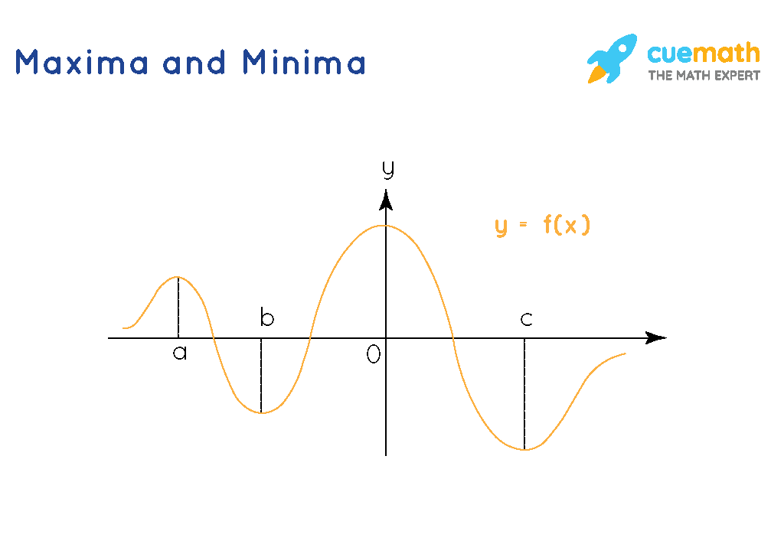

The combination of maxima and minima is extrema. In the image given below, we can see various peaks and valleys in the graph. At x = a and at x = 0, we get maximum values of the function, and at x = b and x = c, we get minimum values of the function. All the peaks are the maxima and the valleys are the minima.

Slide 13
First of all, by polynomial rules, there will be no absolute maximum or minimum. Since the highest degree term is of degree 3 (odd) and the coefficient is positive (2), at left of the graph we will be at (-x, -oo) and work our way up as we go right towards (x, oo). This means there will at most be a local max/min. To find these, we start by finding the derivative.
we start by finding the derivative.
f'(x)=6x2−12x−48
We must now find the critical numbers. These will contain our relative maximum and minimums. This is a polynomial function defined over all values of x. Our only critical point will come when the derivative equals 0.
0=6x2−12x−48
0=6(x2−2x−8)
0=(x−4)(x+2)
x=4and−2

Slide 14
The next step is to check the sign of the derivative on both sides of the critical numbers. If f'(x)<0, then f(x) is decreasing, but if f'(x)>0, the f(x) will be increasing.
Test point 1: x=5
f'(5)=6(5)2−12(5)−48=42
Test point 2: x=3
f'(3)=6(3)2−12(3)−48=54−36−48=−30
So, x=4 is a local minimum value.
Test point 3: x=−1
f'(−1)=6(−1)2−12(−1)−48=6+12−48=−30
Test point 4: x=−3
f'(−3)=6(−3)2−12(−3)−48=54+36−48=42

Slide 15
Therefore, x=−2 is a local maximum. Everything we have found algebraically agrees with what can be seen in the following graph of f(x).
graph{2x^3- 6x^2 - 48x + 24 [-10, 10, -5, 5]}

Slide 16
Binomial is a polynomial with only terms. For example, x + 2 is a binomial, where x and 2 are two separate terms. Also, the coefficient of x is 1, the exponent of x is 1 and 2 is the constant here. Therefore, A binomial is a two-term algebraic expression that contains variable, coefficient, exponents and constant.
Another example of a binomial polynomial is x² + 4x. Thus, based on this binomial we can say the following:
x² and 4x are the two terms
Variable = x
The exponent of x² is 2 and x is 1
Coefficient of x² is 1 and of x is 4

